Slide 1




Illustrer son propos
David Beauchesne & Pierre Legagneux, 13 Mars 2019

Slide 2
Outline…
- Histoire
- Types de visualisation graphique
- Bonnes vs mauvaises visualisation
- Bases
- Couleurs
- Reproductibilité
- Outils

Slide 3
Une image vaut mille mots
Résumé visuel de données et de résultats
Plus efficace que des tables et du texte (si c’est bien fait !)
Exploration de données
Tendances, corrélations, cycles, données extrêmes, etc.
Essentiel pour présenter des résultats
Capte l’attention / qualité du travail

Slide 4

Un peu d’histoire…

Slide 5
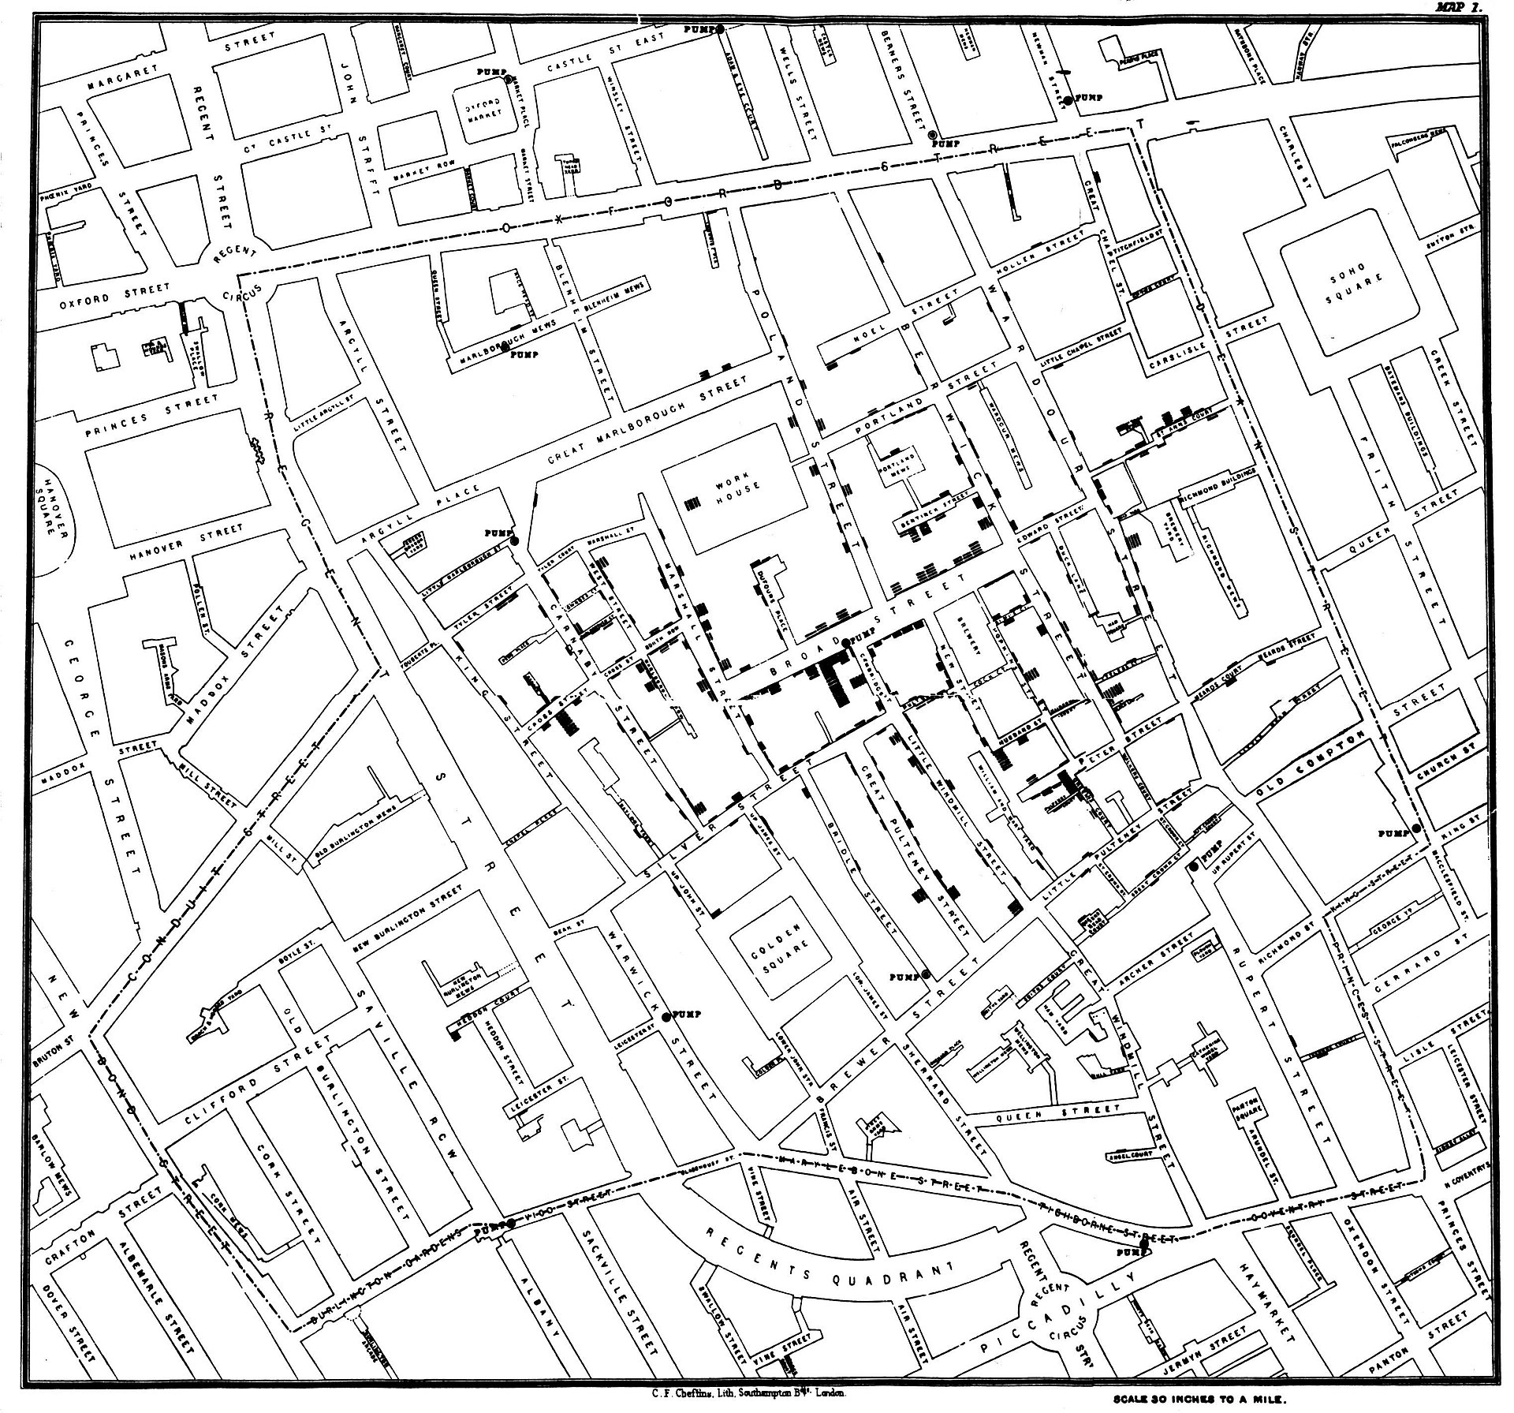
Un peu d’histoire…

Slide 6
Data visualisation types
Tables
Graphical abstract
Figures
Static
Dynamic
Interactive
Maps
Static
Dynamic
Interactive
Supplementary materials
Audio
Video
Websites

Slide 7
Figures & other data visualisation
Choose the appropriate representation type that is relevant to your research question
Figures can make or break a paper
If you read a paper quickly, the most important thing is the figures ( plus title & abstract !)
Figures should speak by themselves – they do not need to be completely explained in the text.
If you can’t make a figure, your data or understanding is not complete enough
You should be able to follow your story just by looking at the figures
Don’t make a figure if you can borrow it from someone (with permission) for example a nice map of the study site

Slide 8
Crappy Figures can help interpreting data

Slide 9

Figures & data analyses
Help to understand/interpret a dataset
If you have multiple variables, start with descriptive figures
Zuur et al. 2010, a key reference

Slide 10
TABLES…
Relevant to present descriptive statistics or model selection, not to highlight the main results of a paper
If tables are really long, put them as an appendix
Consider to publish the raw data (open science)

Slide 11
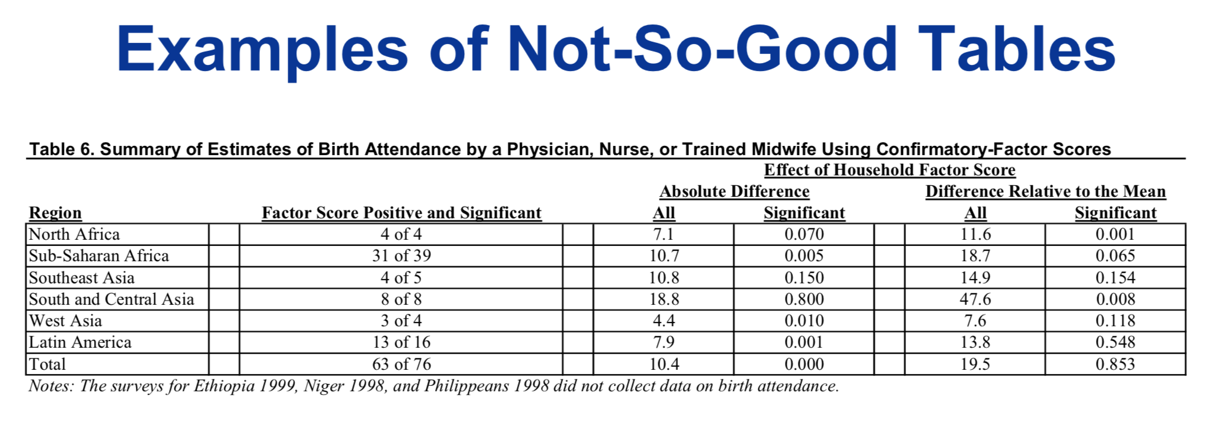
TABLES…

Slide 12
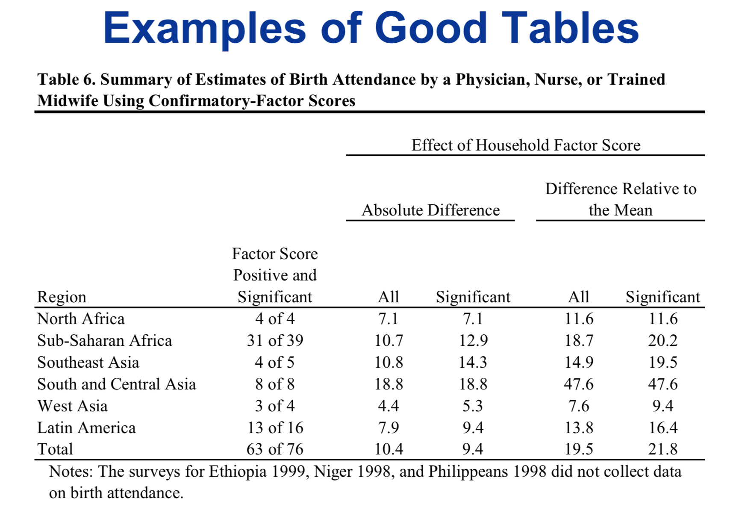

Slide 13
Graphical abstracts
Cyanobacterial diversity in the hot spring, pelagic, and benthic habitats of a tropical soda lake
Dadheech, P. K., Glöckner, G., Casper, P., Kotut, K., Mazzoni, C. J., Mbedi, S., & Krienitz, L. (2013). FEMS microbiology ecology, 85(2), 389-401.
Cross talk between activation of microglia and astrocytes in pathological conditions in the central nervous system
W. Liu, Y. Tang, J. Feng, Life Sciences, Volume 89, Issues 5-6, 1 August 2011, Pages 141- 146.
Habitat fragmentation drives inter-population variation in dispersal behavior in a Neotropical rainforest bird
Cornelius, C., Awade, M., Cândia-Gallardo, C., Sieving, K. E., & Metzger, J. P. (2017). Perspectives in Ecology and Conservation, 15(1), 3-9.

Slide 14
Figures…
https://datavizproject.com/

Slide 15
Junk Charts Trifecta Checkup
https://junkcharts.typepad.com/junk_charts/junk-charts-trifecta-checkup-the-definitive-guide.html
What is the QUESTION?
What does the DATA say?
What does the VISUAL say?
What is the practical question ?
What does the data say ?
What does the chart say ?

Slide 16
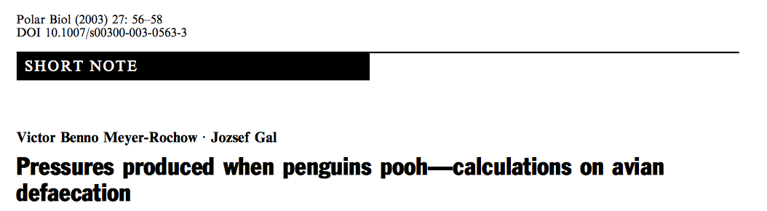

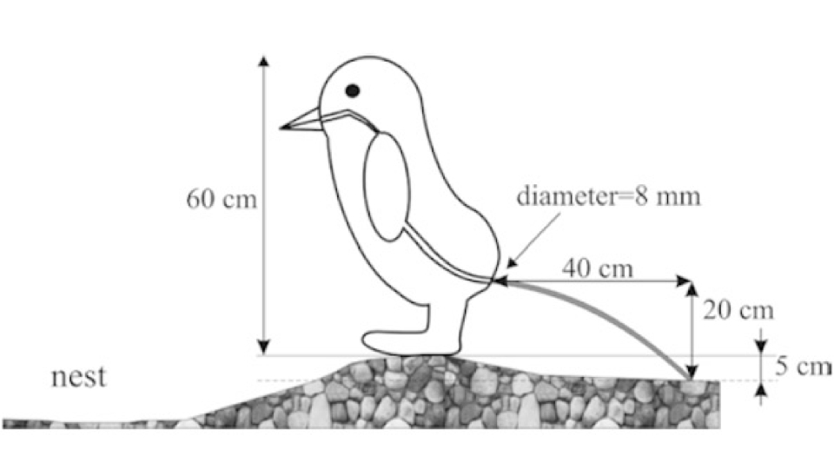
Figures
2005 Winner

Slide 17

Figures
Figure 3 The cardiac hypertrophic response to pressure overload. Wild-type and TGJ1 mice were subjected to transaortic constriction and analysed after 1 week. (A) The percentage of cardiac cells demonstrating Notch1 (left) or Notch2 (right) activation after transaortic constric- tion. (B) Heart sections stained with antibodies against laminin (green). (C) Cardiomyocyte size distribution. (D) Cardiomyocyte cross-sectional area (mean+SEM). (E) Post-mortem left ventricular weight in wild-type and TGJ1 mice. (F) Notch target gene expression using qRT–PCR (upper panel) and cardiac hypertrophy marker expression (lower panel) in wild-type and TGJ1 hearts. Data are expressed as fold change rela- tive to wild-type Sham. Data in (A), (D), (E), and (F) are presented as mean + SEM (*P , 0.05 in transaortic constriction vs. Sham; †P , 0.05 in TGJ1 vs. wild-type; six mice per group). In (C) and (D), values are obtained from at least 700 cells per group. Scale bar in (B) 50 mm.

Slide 18
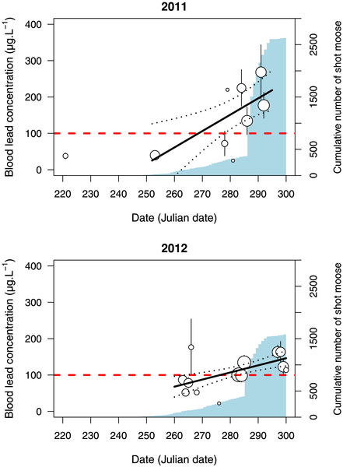
Figure 1. Relationship between blood lead concentrations in common ravens and date in 2011 and 2012.
Dot size is proportional to the log of the sample size. Error bars represents SE. Dotted lines represent the 95%CI. The light blue barplot illustrates the cumulative number of rifle-shot moose in the hunting area selected for the study. Ravens with no sign of clinical contamination were reported to have lead concentration <100 µg.L⁻¹ (horizontal red dashed line) according to [28].
Legagneux P, Suffice P, Messier JS, Lelievre F, Tremblay JA, et al. (2014) High Risk of Lead Contamination for Scavengers in an Area with High Moose Hunting Success. PLoS ONE 9(11): e111546. doi:10.1371/journal.pone.0111546
http://127.0.0.1:8081/plosone/article?id=info:doi/10.1371/journal.pone.0111546

Slide 19
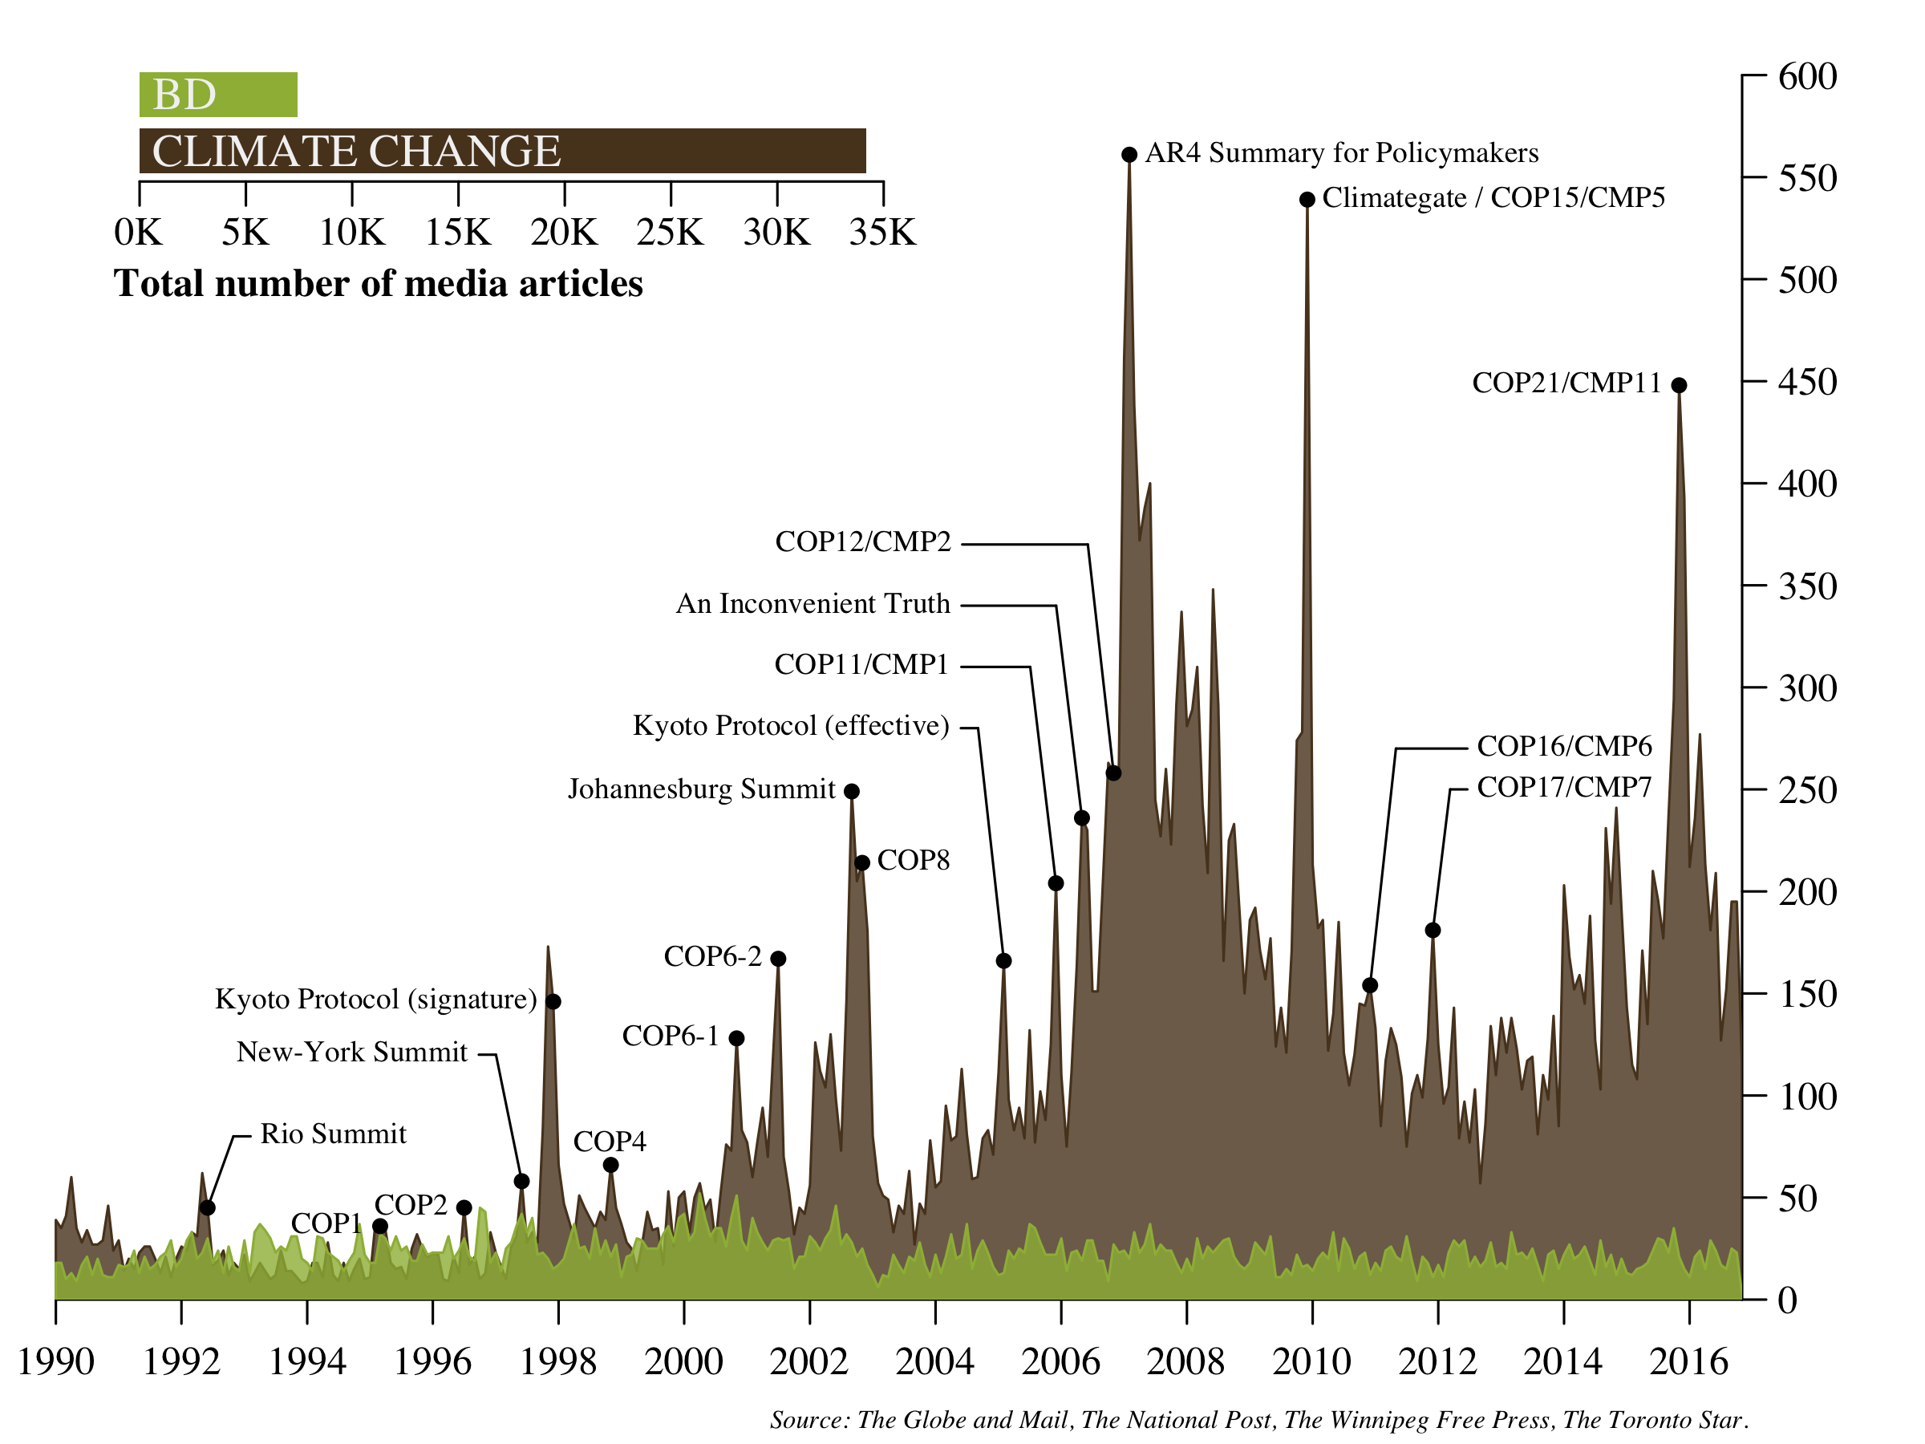





Legagneux et coll. Frontiers in Ecology 2018

Slide 20
RELEVANT WEBSITES
https://datavizproject.com/
http://jasonya.com/wp/science-figures-we-could-do-without/
https://junkcharts.typepad.com

Slide 21
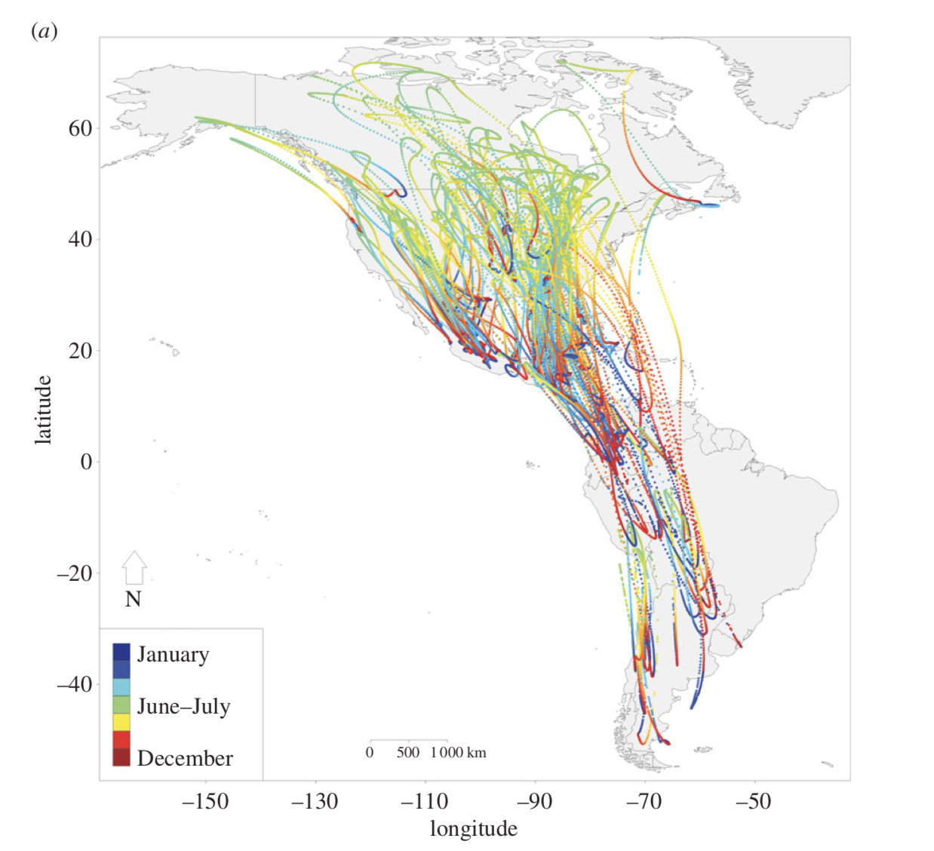

From static to dynamic figures

Slide 22
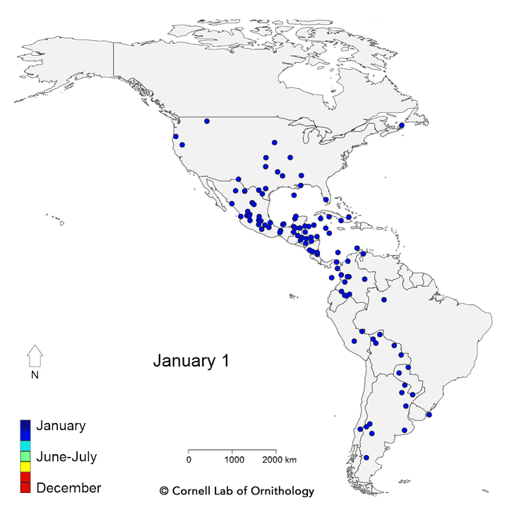
From static to dynamic figures
https://www.nationalgeographic.com/magazine/2018/03/bird-migration-interactive-maps/

Slide 23

Figures
You will redo your figures many times, so ideally, keep the raw data used to make the figure in the same folder as the figure
In word, a table with invisible or white lines is a great way to put a figure into the text … but remember that you will have to produce your figure as a separate file when your paper will be accepted for publication.
Tip: try to use R and perform your figures based on an R script that generates the figure directly from the raw data

Slide 24
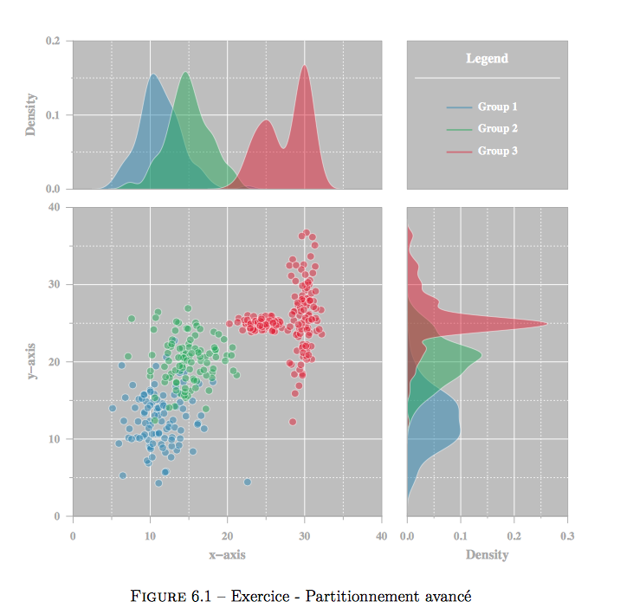
Figures
http://nicolascasajus.fr/doc/graphonr.pdf

